Slide 1
USCD Embedded C Assignment 2
By
Hsuankai Chang
hsuankac@umich.edu

Slide 2
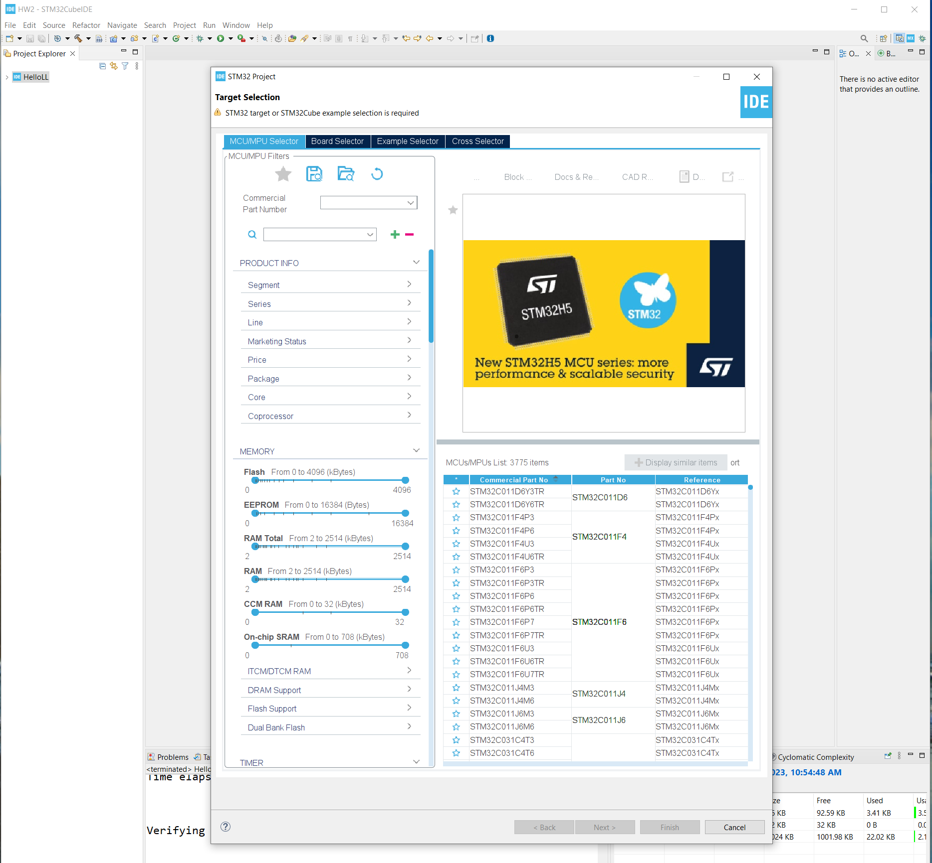
Step 1. Startup STM32CubeIDE and create new STM32 project

Slide 3
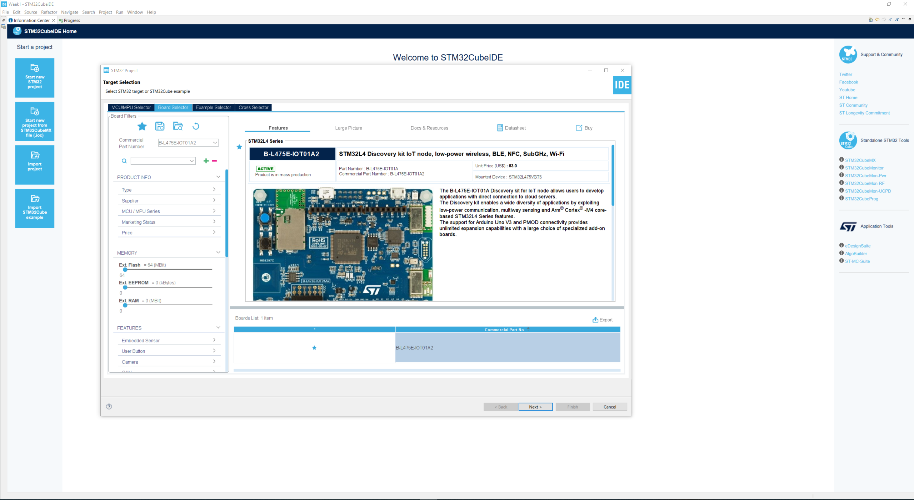
Step 2. Access board selector and type in the board you use, click Next

Slide 4
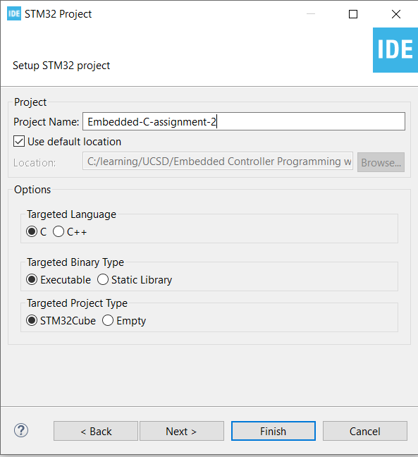
Step 4. Enter the project name then click Finish

Slide 5
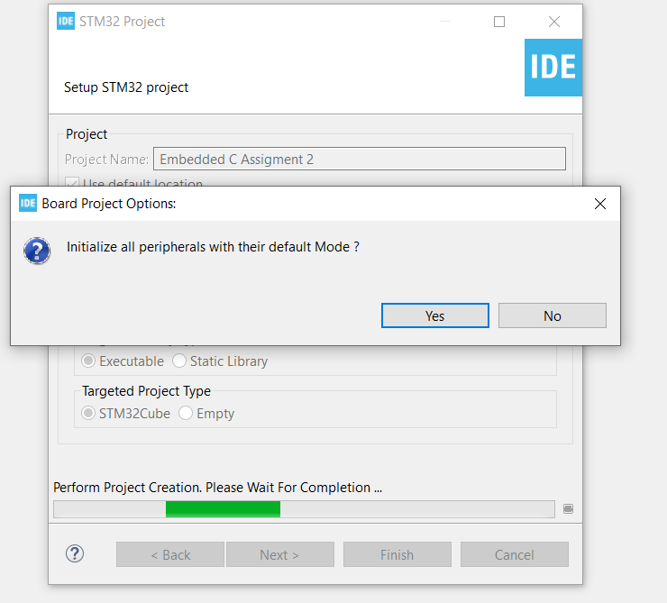
Step 5. Click yes to initialize all peripherals to default

Slide 6
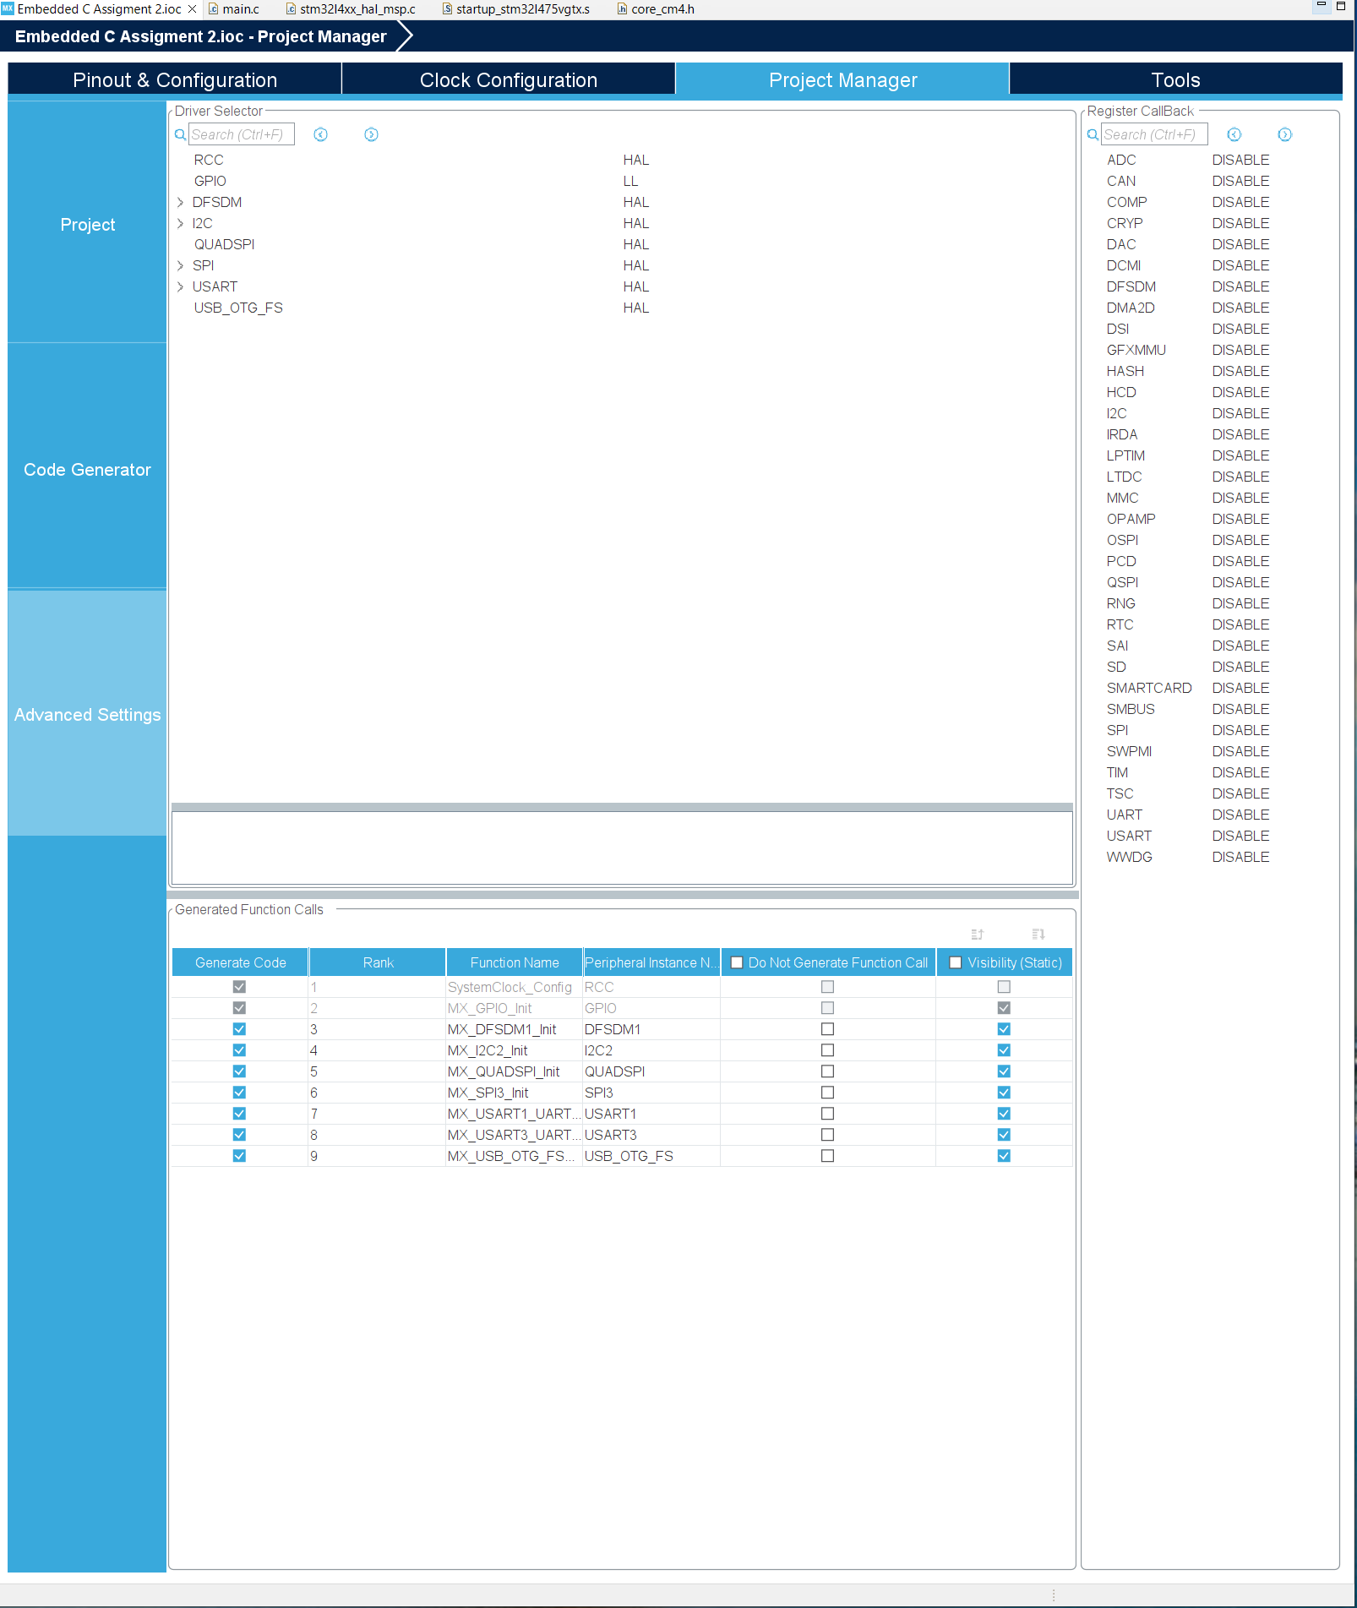
Step 6. When in .ioc file, click Project Manager -> advanced settings -> Driver Selector and change the GPIO driver to use LL

Slide 7
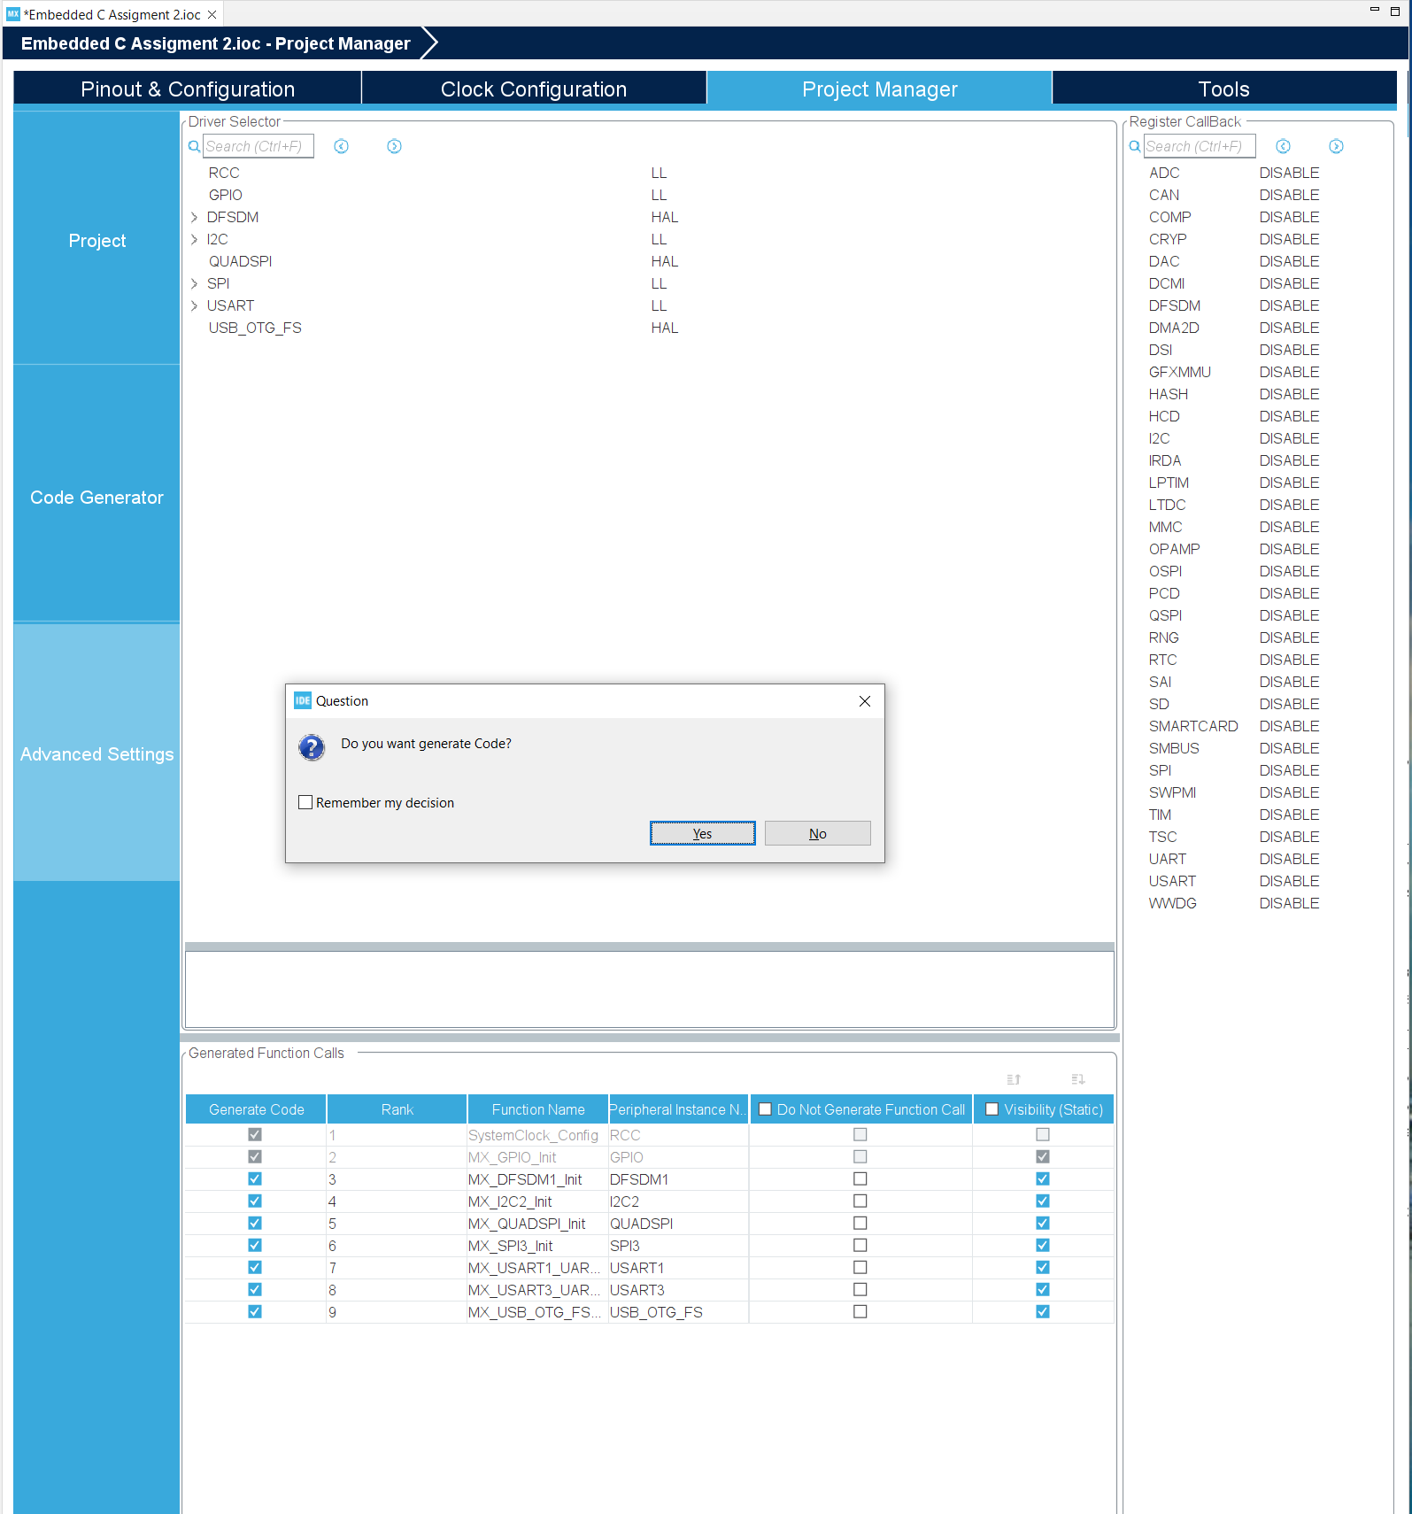
Step 7. Save and click yes to generate code

Slide 8
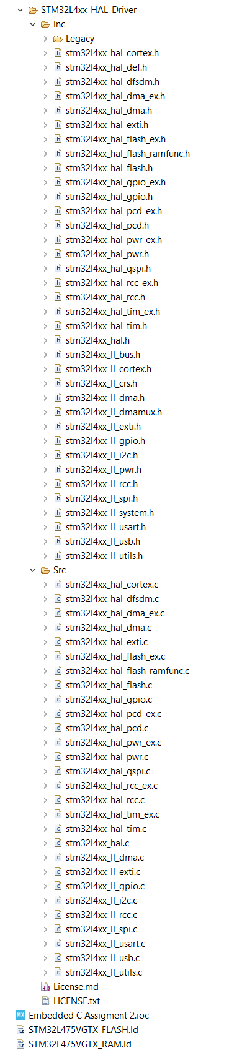
Step 8. See if we have all the needed LL file included in the file folder

Slide 9
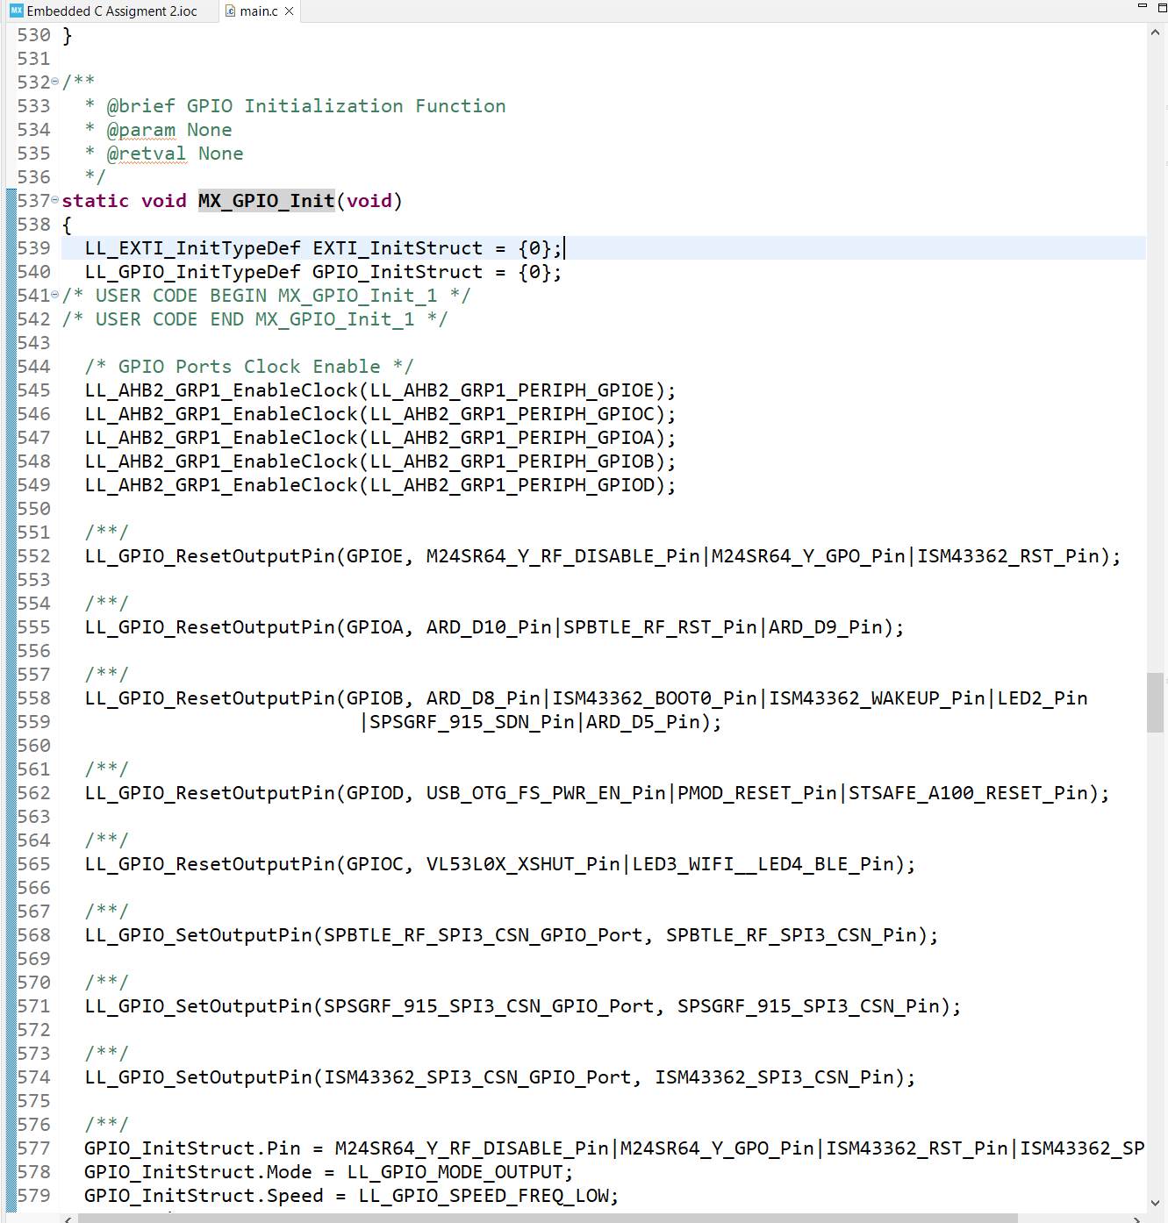
Step 9. Find GPIO Init code that initializes the LED2 using LL (highlighted in blue below)

Slide 10
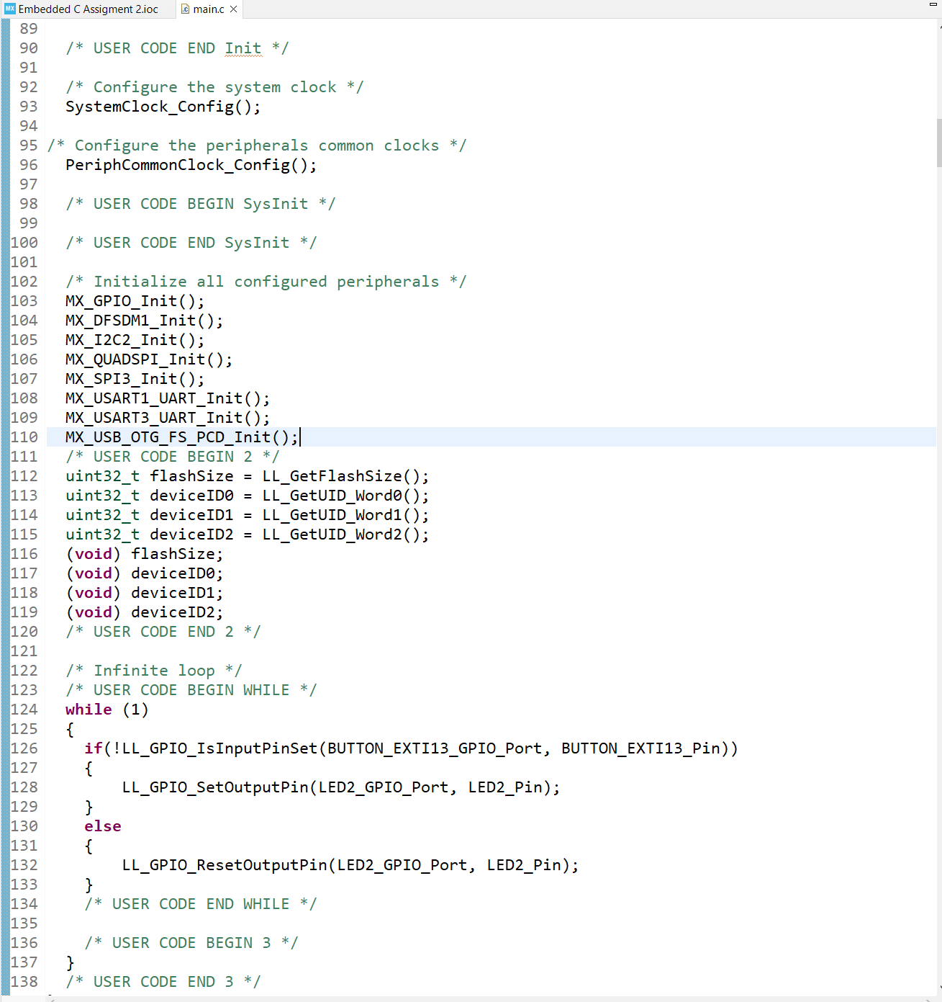
Step 10. Enter the code in CODE BEGIN section to get the flash size and device ID per requirement

Slide 11
Step 11. If the blue button is pushed, turn on the LED2, else, turn it off

Slide 12
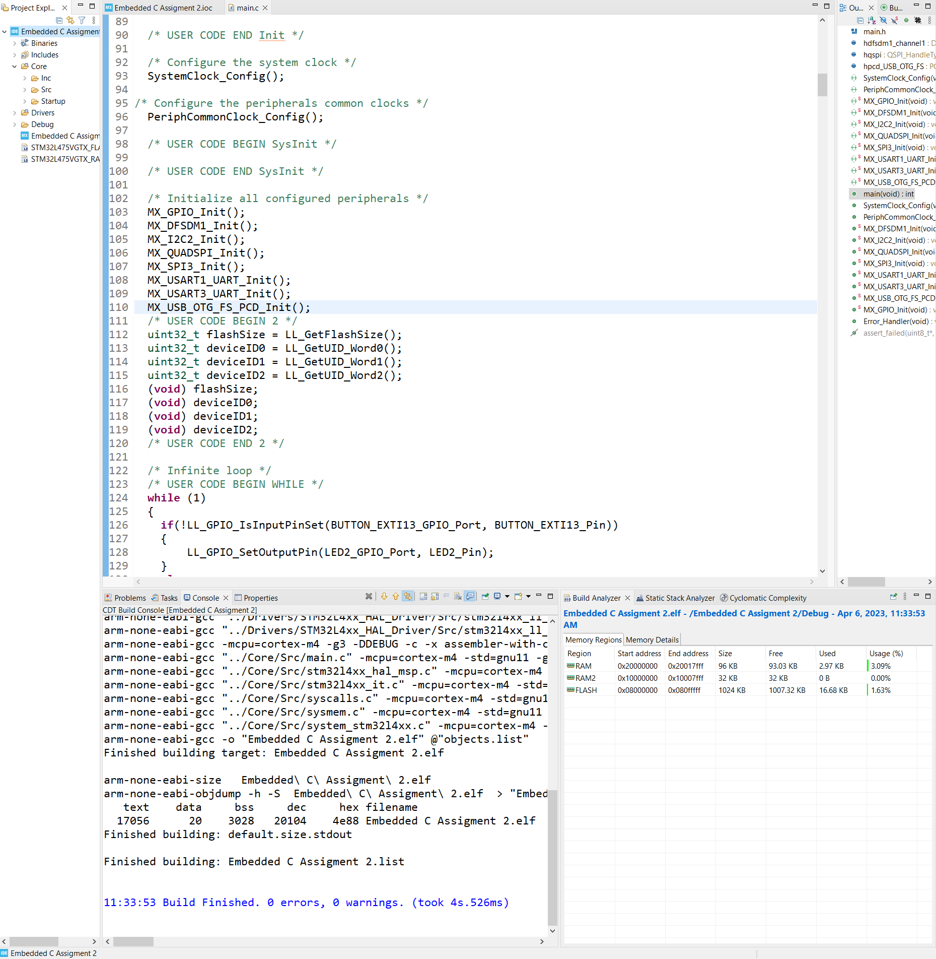
Step 12. Right click on the project name and build it, test the .elf file, also examine the RAM and FLASH size

Slide 13
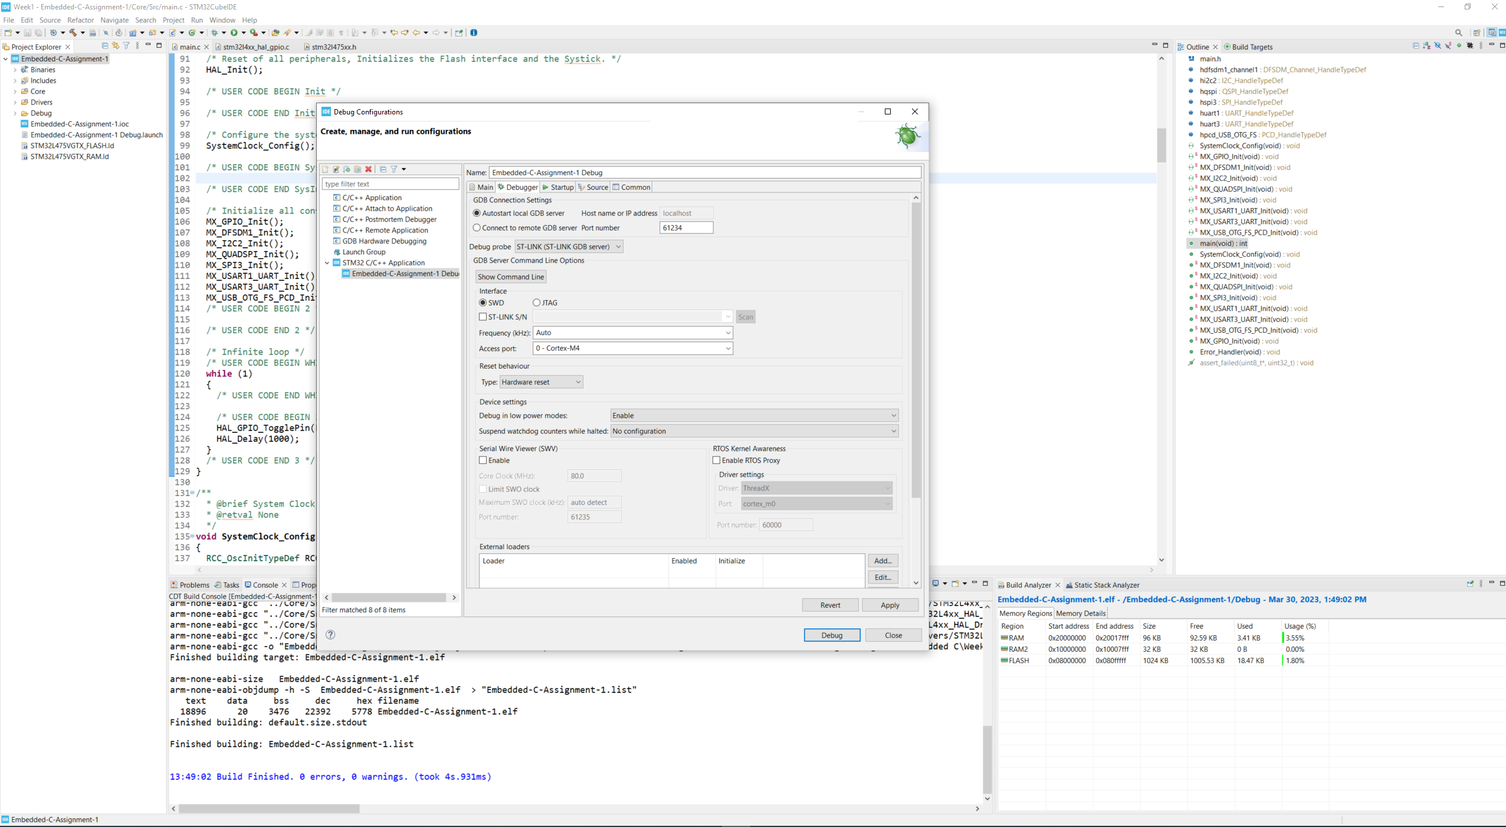
Step 13. Setup for debug configuration, test on the board. If you press the blue button, the LED will be on

